Slide 1
DEPI Networks Project
Team Members
Abdallah Mohamed
Amr Khaled El-Sayed
Karim Adel
Omar Khaled Mahmoud
Mohamed Abou Rabah
Zeyad Magdy

Slide 2
Contents
1- Project Tasks
2- Network Diagram
3- Tasks Overview

Slide 3
Project Tasks
Task # | Task Name
Task 1 | Network Design
Task 2 | Initial Configurations
Task 3 | VLANs and Inter-VLAN Routing Configuration
Task 4 | OSPF, HTTP, HTTPs, DNS, and DHCP Configurations
Task 5 | Network Security
Task 6 | Network Testing

Slide 4
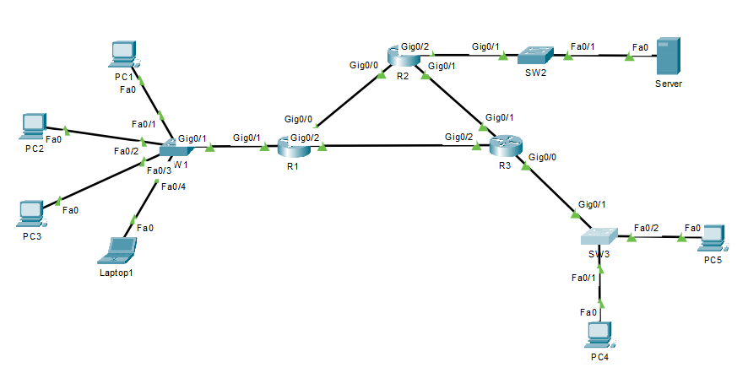
Network Diagram

Slide 5
Tasks Overview
Network Design
Initial Configurations
VLANs and Inter-VLAN Routing Configuration
OSPF, HTTP, HTTPs, DNS, and DHCP Configurations
Network Security
Network Testing

Slide 6
Thank You

